Slide 1
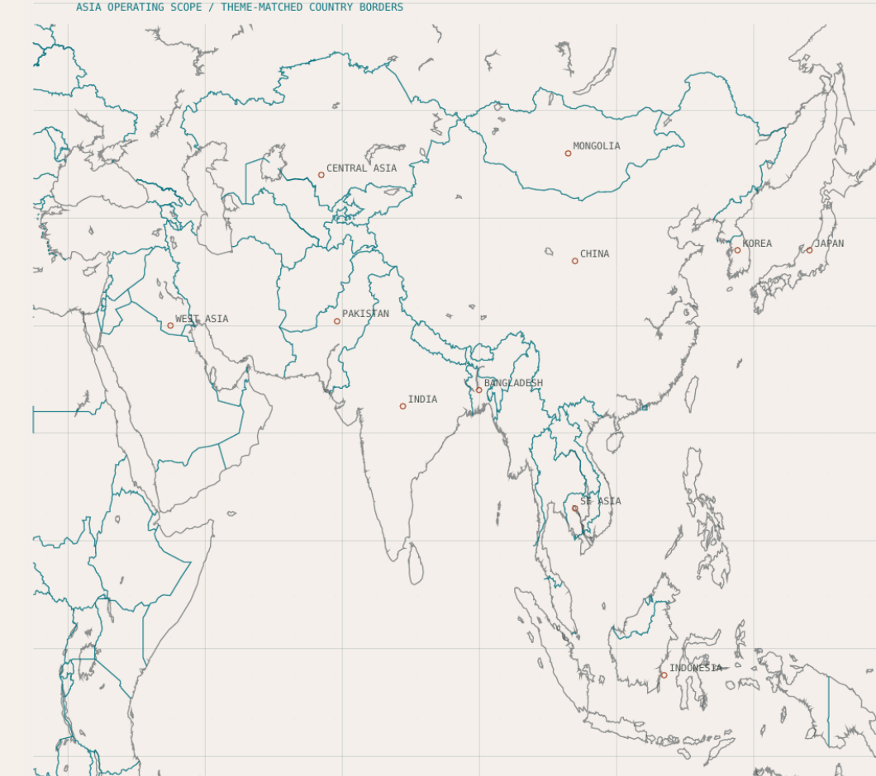
WIAAS ASIA FIELD ATLAS
PLATE 01 - FIELD BRIEFING
ALIBABA CLOUD HACKATHON SUBMISSION
Asia operating scope / theme-matched country borders
WIaaS Asia
Weather Intelligence as a Service
A pan-Asian decision layer that turns weather evidence into practical operational intelligence for farms, utilities, logistics teams, outdoor workers, and emergency coordinators.
Developed with Qoder. Orchestrated with n8n. FastAPI calculates deterministic weather, grid, water, and resource metrics before any language model interprets them.
Made by Muhammad Abdullah
LinkedIn: mohammad-abdullah-25ba1721b
GitHub: abdxllxh/WIAAS---Asia
DEVELOPED WITH QODER + N8N ORCHESTRATION
01 / 12

Slide 2
WIAAS ASIA FIELD ATLAS
PLATE 02 - PROBLEM DEFINITION
DIAGNOSTICS
The operational gap
Forecast data exists. Teams still spend critical time translating it into a decision.
01
02
03
Forecasts stop before the decision
Teams interpret separate views
Local context changes the risk
Weather products report conditions and probabilities. Operators still decide when to irrigate, slow outdoor work, protect grid capacity, or reroute deliveries.
Farms, utilities, logistics teams, and crisis desks often work from different dashboards. The result can be slower and inconsistent action.
Coastal humidity, desert heat, monsoon runoff, typhoon exposure, and mountain hydrology require city and district-level decisions.
WHY WIAAS EXISTS
WIaaS keeps the selected location attached to a shared physics-based state. The workflow then activates only the decision path needed by the operator, instead of forcing every question through the same large prompt.
DEVELOPED WITH QODER + N8N ORCHESTRATION
02 / 12

Slide 3
WIAAS ASIA FIELD ATLAS
PLATE 03 - PLATFORM THESIS
RESPONSE ARCHITECTURE
Backend-first decision intelligence
Calculations happen first. AI interprets the bounded result and communicates the action.
01 DATA INGEST
02 PHYSICS ENGINE
03 DECISION ROUTING
04 FIELD ACTION
Open-Meteo telemetry, region registry, map selection, radar context, and the operator question.
VPD, heat index, wet bulb, grid demand change, evaporation stress, and resource ledger.
Rules choose a direct metric, operational report, specialist branch, or CrisisLens threat assessment.
A structured brief explains what matters for the selected role and location without hiding limits.
PHYSICS SIGNAL USED BEFORE MODEL TEXT
SYSTEM BOUNDARY
VPD = e_s(T) x (1 - RH / 100)
This side is the main difference: predictable calculations do not need a model call, while interpretation and action planning receive a compact state vector with missing evidence clearly labeled.
DEVELOPED WITH QODER + N8N ORCHESTRATION
03 / 12

Slide 4
WIAAS ASIA FIELD ATLAS
PLATE 04 - TWO AGENT SYSTEM
SHARED STATE
Two agents, one weather state
Daily operations and emergency intelligence use the same location, telemetry, and calculated metrics.
WIaaS Agent
CrisisLens Agent
Operational intelligence for routine decisions.
Emergency intelligence for hazard response.
Research branch explains baselines, current evidence, and uncertainty.
Routes threat, evidence, severity, action and follow-up questions separately.
Agriculture branch turns VPD, heat and moisture into crop and irrigation guidance.
Correlates Open-Meteo, GDACS, GDELT and configured FIRMS signals.
Grid and logistics branches translate weather stress into capacity, fuel and route pressure.
Keeps observation, inference, confidence and missing sources visible.
Conversation branch answers direct questions in English or Urdu with session context.
Returns stakeholder-specific guidance for citizens, farmers, utilities and emergency teams.
SHARED INPUTS
Region key, city, country, coordinates, timezone, climate context, telemetry, VPD, wet bulb, heat index, wind, rainfall context, resource ledger, and recent session state.
DEVELOPED WITH QODER + N8N ORCHESTRATION
04 / 12

Slide 5
WIAAS ASIA FIELD ATLAS
PLATE 05 - WIAAS AGENT BRANCHES
OPERATIONAL INTELLIGENCE
Same weather state, many operational decisions
Each branch receives the same calculated state, but returns guidance for a different job.
Research brief
Logistics continuity
baselines, evidence, limits
route disruption and fuel overhead
Agriculture guidance
SHARED CALCULATED STATE
Conversation response
irrigation, crop stress, disease pressure
FastAPI completes physics before workflow reasoning
short English or Urdu answers
Grid outlook
Safe fallback
capacity headroom and cooling load
states limits when evidence is unavailable
DESIGN RULE
Role-specific guidance can change. The evidence base and selected location remain consistent.
DEVELOPED WITH QODER + N8N ORCHESTRATION
05 / 12

Slide 6
WIAAS ASIA FIELD ATLAS
PLATE 06 - CRISIS INTELLIGENCE
CRISISLENS AGENT
Evidence to a safe threat response
CrisisLens gathers local signals, records uncertainty, and returns guidance for the stakeholder who needs it.
Open-Meteo
Citizens & workers
weather, apparent heat, wind, rain
exposure timing and protection steps
GDACS
THREAT
ASSESSMENT
Farmers
official disaster-alert context
crop, livestock and irrigation response
severity + confidence
GDELT
Emergency teams
regional news and situational context
public warning and response priorities
NASA FIRMS
Grid & logistics
optional active-fire feed; key required
capacity, route and continuity guidance
SAFETY RULE
Observations and inference stay separate. Confidence and missing sources remain visible.
DEVELOPED WITH QODER + N8N ORCHESTRATION
06 / 12

Slide 7
WIAAS ASIA FIELD ATLAS
PLATE 07 - WIAAS WORKFLOW SYSTEM
WORKFLOW SYSTEM
WIaaS operational workflow
The current n8n export routes each request through shared state and only the required specialist branch.
Webhook
Parse
Route
Region
Analytics
State vector
Depth route
Assembler
Response
chat or web payload
message and session
intent and fast path
registry + map state
FastAPI telemetry
bounded evidence
fast or specialist
strict JSON builder
chat / report JSON
Fast route
Research
Agriculture
Grid
Logistics
Memory
direct metric or FAQ
evidence meaning
crop and water
capacity pressure
route continuity
recent session context
58 NODES IN THE CURRENT EXPORT. REPEATED VALIDATION, FALLBACK AND RESPONSE FORMATTING STAGES ARE GROUPED IN THIS VIEW.
DEVELOPED WITH QODER + N8N ORCHESTRATION
07 / 12

Slide 8
WIAAS ASIA FIELD ATLAS
PLATE 08 - CRISISLENS WORKFLOW SYSTEM
WORKFLOW SYSTEM
CrisisLens emergency workflow
The current n8n export resolves the location, gathers configured evidence, scores the threat, and saves the result.
Webhook
Memory
Intent + geo
Evidence fan-out
Normalize
OSINT score
Action
Save state
Response
crisis request
last region and result
route and coordinates
configured API calls
filter distant signals
severity + confidence
stakeholder guidance
session memory
safe chat JSON
Cached follow-up
Safe fallback
reuse recent severity
missing evidence visible
PARALLEL EVIDENCE SOURCES
Open-Meteo
GDACS
GDELT
FIRMS optional
weather + heat
disaster alerts
news context
API key required
47 NODES IN THE CURRENT EXPORT. REPEATED PARSING, SOURCE SKIPS AND RESPONSE FORMATTING ARE GROUPED IN THIS VIEW.
DEVELOPED WITH QODER + N8N ORCHESTRATION
08 / 12

Slide 9
WIAAS ASIA FIELD ATLAS
PLATE 09 - MODEL USE AND TRACEABILITY
CONTROLLED ORCHESTRATION
Routing controls model use
The workflow reduces and labels evidence before specialist reasoning begins.
Typical one-prompt pattern
WIaaS routed intelligence
Engineering benefit
Raw data, full chat history and every instruction enter one model call.
Deterministic routing narrows the task before any model call.
Smaller context means fewer irrelevant tokens.
The source of each conclusion becomes harder to trace.
Compact state vectors keep only relevant metrics and evidence.
Branch-level reasoning is easier to debug and validate.
Every request pays the cost of the largest prompt.
Cached follow-ups reuse recent severity and evidence.
Strict JSON keeps frontend parsing stable.
01
ZERO-TOKEN ROUTING
02
COMPACT STATE
03
SPECIALIST BRANCH
04
CACHED FOLLOW-UP
05
STRICT JSON
06
NO-INVENTION FALLBACK
DEVELOPED WITH QODER + N8N ORCHESTRATION
09 / 12

Slide 10
WIAAS ASIA FIELD ATLAS
PLATE 10 - BACKEND INFRASTRUCTURE
FASTAPI CORE
FastAPI owns the measurable state
The backend resolves locations, normalizes weather, calculates physics, and builds the values used by both agents.
Routes
analytics, grid outlooks, client location, static frontend, TTS
Weather pipeline
Open-Meteo signals cached and normalized into one schema
Physics engine
VPD, heat index, wet bulb and stress indicators before model reasoning
Resource ledger
water loss, irrigation efficiency, grid demand, fuel overhead and capacity
Agent bridge
structured payloads to WIaaS and CrisisLens workflows
Bilingual speech
English and Urdu input/playback for field operators
TETENS SATURATION PRESSURE
AGRICULTURE AND HEAT STRESS SIGNAL
e_s(T) = 0.61078 x exp(17.27T / (T + 237.3))
VPD = e_s(T) x (1 - RH / 100)
DEVELOPED WITH QODER + N8N ORCHESTRATION
10 / 12

Slide 11
WIAAS ASIA FIELD ATLAS
PLATE 11 - WIAAS ADVANTAGE
DIFFERENTIATION
Why this is stronger than another weather dashboard
WIaaS Asia turns observation into bounded decisions, with the backend and workflows sharing responsibility.
Platform advantage
Workflow advantage
Not only forecast viewing: it produces role-specific action for real work.
A direct metric can stay on the fast path instead of calling every specialist.
Asia-specific context travels with the region: country, city, timezone and coordinates.
Specialist branches receive only the fields needed for their job.
Physics values are calculated before prose, so answers can be traced back to metrics.
Memory and cached follow-ups reduce repeated API/model work in the same session.
Same state feeds both routine operations and emergency intelligence.
No-invention fallback keeps missing evidence visible instead of hiding it.
DECISION PRINCIPLE
Weather signal -> deterministic state -> routed workflow -> practical next step.
DEVELOPED WITH QODER + N8N ORCHESTRATION
11 / 12

Slide 12
WIAAS ASIA FIELD ATLAS
PLATE 12 - IMPACT AND PRODUCTION PATH
FINAL FIELD NOTE
Weather evidence connected to a defensible next step
The platform helps people who need to act before weather turns into operational loss.
FARMERS
WORKERS
BUSINESS
GRID TEAMS
EMERGENCY
irrigation timing
crop stress
water loss
heat exposure
unsafe windows
hydration guidance
route risk
continuity
fuel pressure
cooling load
capacity pressure
transformer stress
severity
confidence
action protocol
CURRENT BUILD
FastAPI physics, MapLibre Asia map, WIaaS workflow, CrisisLens workflow, bilingual chat, neural speech, and structured decision output. The next production step is observability, managed secrets, source health checks, and calibrated regional validation.
DEVELOPED WITH QODER + N8N ORCHESTRATION
12 / 12

